Slide 1
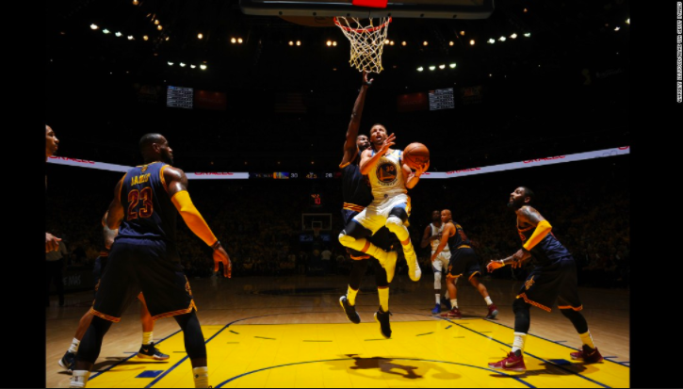
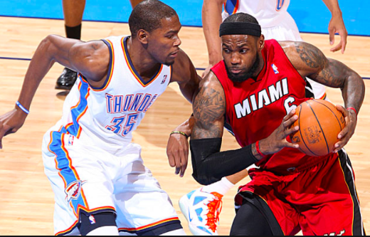
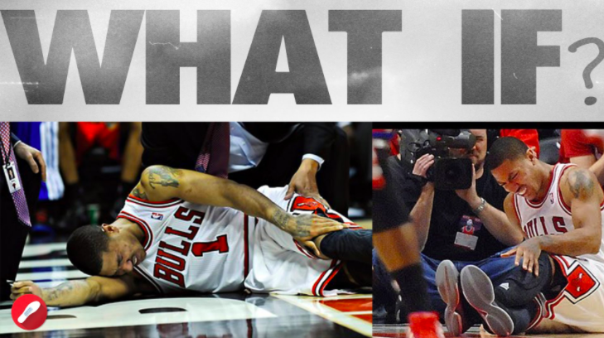
DATA SCIENCE IN R:
BASKETBALL END-GAMES
Quantifying team win probabilities late in basketball games
to better understand and mitigate million dollar risks
Notes:
Basketball is one of the most popular sports in the world. What if we could see into the future of a basketball game and make verifiable predictions?
There are a lot of different predictions or recommendations an analyst can make. Franklin Kenter’s famous paper (hacking basketball) broke down the endgame of basketball into zones where he recommended specific actions like foul, or shoot a 2, or shoot a 3. This paper takes a smaller scope, in only recommending action that a coach should take regarding substitutions. Specifically, this project aimed to find that mathematical envelope where the dwindling time-remaining becomes too great an obstacle for an underdog given the score, no matter who is on the basketball court or what they are doing.
At the end of the day I’m a nice guy, I feel the pain of Derrick Rose getting hurt and I want to make it a better world where guys like him ice their kees on the bench in garbage time, not get run into the ground by confused coaches. Believe me, I am frusterated more than anyone by a lot of the coaching even at the highest levels, I’ve had to renounce my original team NBA citizenship due to their not firing their head coach for the past 5 years. But that’s another story. I’m unique in that I have some extensive basketball knowledge, I’ve played it, refed it for my first job for 2 seasons, and coached it for the youth league as a volunteer. I’m a geek for statistics; and as I’ve been getting stronger with R programming, I’ve really been able to take off the ground so to speak in terms of using data.

Slide 2

Presentation Road Map
Problem Statement: Big Markets, Little Quantification
The Data: Used a simulation and various model validation strategies
Exploratory Visualizations: Seeing the data
Regression Analysis: Key Data Insights
The Product: A Web-App for Communicating Regression Insights
Results & Conclusion
Notes:
You may have heard of a book called Moneyball by Michael Lewis; and it takes the stance that traditional baseball knowledge was flawed, and unproven by rigorous numerical analysis. Baseball being a turn-based game, it was relatively easy to apply outcome-based situational game theoretic probabilities for baseball and really lay things out statistically- baseball became a statistician’s theme park, while basketball has always been under-quantified, as compared to baseball. This type of analysis is built on the 1976 Mertens and Zamir paper outlining how normal distributions describe the game theoretic relationships between the type of zero sum two-actor game environments we see in basketball. Many models try to throw in the whole kitchen sink and let regression sort out all the details; however via Mertens and Zamir and only starting with normal distributions, this analysis differs from saying “let’s think more and add more” to “let’s take a step back and using programmable random normal distributions as the atomic building block,” which R makes easy- anyone can create a model that simulates basketball this same way. There are a lot of ways to do it, and there really were 3 less-good versions before GameflowMaker4, and I won’t bore you by showing you those, but they worked for what they did, it’s just that Gameflowmaker4 was just the first function in the series that didn’t have any kinks left to work out.

Slide 3
Problem Statement
From player salaries to online sports gambling - basketball has become a billion dollar business, and as star players’ salaries now cross $30 million annually, mitigating the risk of needless injury to highly paid NBA players is key for preserving and protecting capital.
In 2012, the NBA MVP and star of the Chicago Bulls was badly injured while playing deep into what this project will argue was “Garbage Time,” indicating this was a needless injury that could be avoided using a more statistically robust method of dynamic end-game probability analysis that will be offered by this project as an open source web application.
Notes:
Time to explain the Derrick Rose story

Slide 4
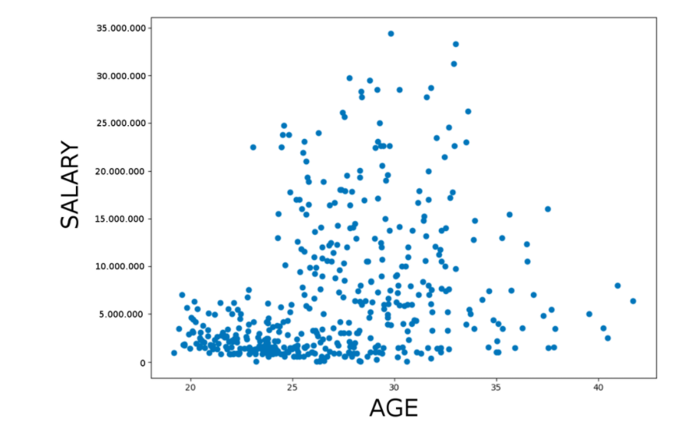
The Problem: Big Asymmetrical Risks, Snapshot
NBA player salaries skew up over $30mm
Most players paid under $5mm
NBA avg is $6mm
NBA players have the highest salaries in pro sports
Notes:
Here salary is broken down by age so we can get a closer look at the raw data of how much NBA players are paid. Adding up the $6 million average over the NBA’s roughly 491 players yields roughly $2 billion annually on the table paid out to players.

Slide 5
Big Markets - Little Quantification
“In the United States today, we have an estimated $150 billion being wagered on sports betting. Only $4.5 billion of that is taking place in Nevada"
-Geoff Freeman, CEO & President of the American Gaming Association
“We might just base our opinion on what we saw in the first half and what we expect in the second half.”
- Jay Kornegay, executive vice president of race and sports
at Superbook Westgate Las Vegas, on making late-game odds
Notes:
It’s hard to put this, there’s a wild west frontier out there. No one really quantifies the percent win chances for each team in basketball in real time. That puzzles me but I just have to shrug because it’s easy to build this at this point, or build similar versions.

Slide 6
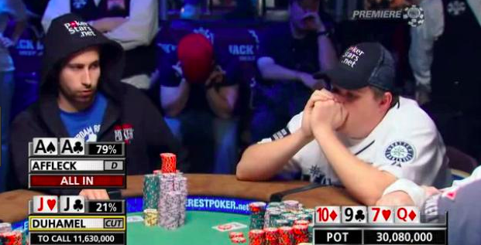
Introducing The Winner Probability Metric
Competitive poker is widely shown with percent chances of winning for each player.
Bemusingly, this is rarely (if ever) seen in basketball.
Notes:
The end-games of games like poker and chess have been mapped out, but basketball really not so yet. This is a big opportunity considering the ranges of estimates for the amount of money that is bet on basketball games annually in the US alone. For example during the NCAA’s March madness there’s an estimated $10 billion changing hands nationwide, which comes out to roughly $30 per American, on March Madness alone. Then there’s the NBA, which is 10x to 20x the market size of March Madness. The NBA itself estimates that by taking a 1% tax on potential gaming revenue, they would yield $2 billion annually; implying the NBA themselves are quoting this market size at roughly $200 billion annually, if legal. $200 billion a year. The net worth of over two Bill Gates’ ...per year. If that doesn’t get your attention I don’t know what will!

Slide 7
Problem - The Derrick Rose Story
- Chicago Bulls worth $600 mm in 2012
- April 28, 2012, Playoffs Game 1
- Derrick Rose, then-reigning 2011 NBA MVP (Most Valuable Player)
- $94.3 million 5 year contract
- Blows out knee during alleged ‘Garbage Time’
- Franchise collapses into mediocrity, Rose traded away
Hometown hero Derrick Rose tragically tore his ACL with 1:08 left to play, after his team led 83-66 at the 10-minute mark.

Slide 8
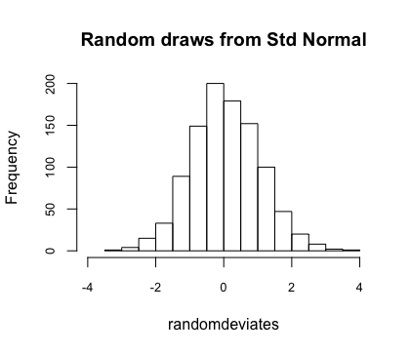
Exploratory Visualizations: R’s “rnorm()” function
Built a probabilistic model “GameflowMaker4” based on normal distributions
R’s rnorm() function was used; normal curves typically govern zero-sum 2-actor games
The rnorm() function creates a customized normal distribution based on user argument-inputs for n, mean, and standard of deviation
Notes:
R’s rnorm() function makes a normal distribution curve.

Slide 9
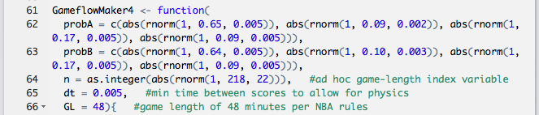
Exploring the Data: User-Defined Model Arguments
probA & probB control the probability of each team’s instantaneous scoring
Each game is broken up into an index based on made baskets
Each row in the output matrix represents one made basket
Output columns are ScoreA, ScoreB, and “MinzLeft” or Minutes Left

Slide 10
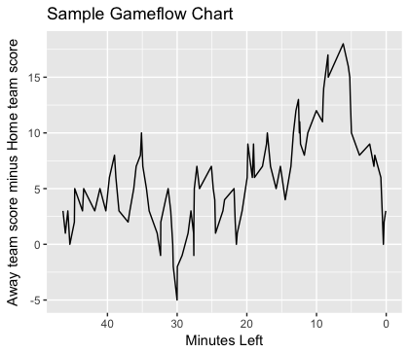
Exploratory Visualizations:
Introducing The Gameflow Chart
First published by Peter Westfall in his 1990 paper “Graphical Presentation of a Basketball Game”
X axis: Time remaining
Y axis: Points difference
Tells the story of a game
Very difficult to clearly depict more than one game at a time without dimension reduction
Notes:
Note that time remaining differs from traditional time, in that it’s negatively counting down, whereas traditional clocks count upwards towards the future. We still think of these charts as flowing left-to-right, since we read left-to-right, so it makes the most sense to have these charts with 0 on the right. So to be technical, the game starts at -48 minutes and counts up to zero, but saying “negative 48 minutes” can sound weird out of context. Also as a mentor-stipulation for this project, I deleted all of the cells where neither team scores, meaning there is no data for tip-off, and that this graph doesn’t exactly start at the origin (0,0) but always within 1, 2, or 3 spaces of the origin.

Slide 11
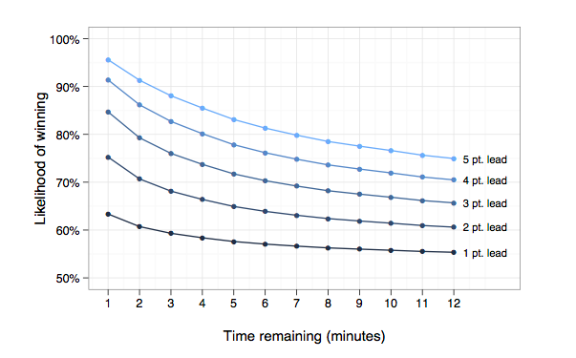
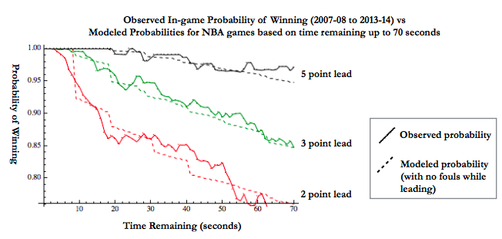
Exploratory Visualizations: Data Reduction
Goel, 2012
Kenter, 2015
Notes:
Note that time remaining differs from traditional time, in that it’s negatively counting down, whereas traditional clocks count upwards towards the future. We still think of these charts as flowing left-to-right, since we read left-to-right, so it makes the most sense to have these charts with 0 on the right. So to be technical, the game starts at -48 minutes and counts up to zero, but saying “negative 48 minutes” can sound weird out of context. Also as a mentor-stipulation for this project, I deleted all of the cells where neither team scores, meaning there is no data for tip-off, and that this graph doesn’t exactly start at the origin (0,0) but always within 1, 2, or 3 spaces of the origin.

Slide 12
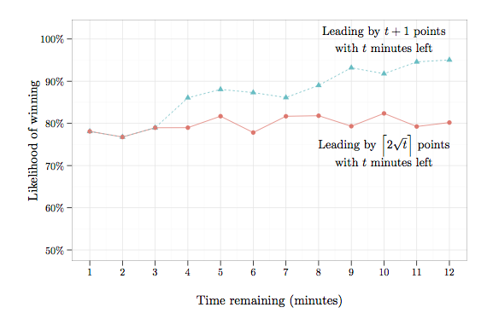
Exploratory Visualizations: Data Reduction
Goel, 2012
Notes:
Note that time remaining differs from traditional time, in that it’s negatively counting down, whereas traditional clocks count upwards towards the future. We still think of these charts as flowing left-to-right, since we read left-to-right, so it makes the most sense to have these charts with 0 on the right. So to be technical, the game starts at -48 minutes and counts up to zero, but saying “negative 48 minutes” can sound weird out of context. Also as a mentor-stipulation for this project, I deleted all of the cells where neither team scores, meaning there is no data for tip-off, and that this graph doesn’t exactly start at the origin (0,0) but always within 1, 2, or 3 spaces of the origin.

Slide 13
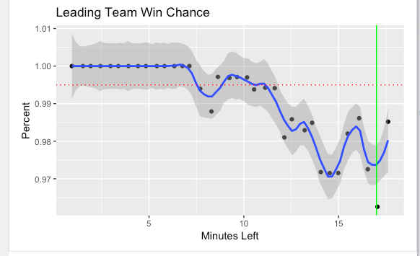
Exploring the Data: Dimension Reduction via Looping
Puzzle: How to meaningfully depict or analyze many gameflow charts / tables at one time?
Strategy: Slice for win probability holding score constant
This is a slice at 17 points’ lead as an example (note 83-66 = 17)
Notes:
Essentially by quantizing the game into time slices, we are turning basketball into a turn based sport like baseball, where each hoop is a turn, and each team has a probability of scoring, and the hoop scored has a probability of being 1, 2, or 3, only, each respectively with its own unique normally distributed randomly selected probability for each team, for each game. This way we get what we see in real life where some games are blowouts, and some games are super competitive and stay close throughout.

Slide 14
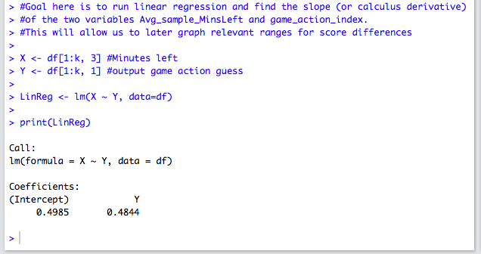
Exploring the Data: Quick Regression of Scoring vs Time
Early Project Challenge: Relating the hoop / loop index to “Minutes Remaining”
Solution: Linear regression to find the coefficients for this relationship
Sliced at the k=35th-to-last hoop
“Basketball games can be reasonably well modeled as a series of independent one-minute rounds consisting of approximately one possession for each team.” -Dr. Sharad Goel of Stanford University
Notes:
These values are telling us that on average the first basket is scored around the first 30 seconds, or one-minus 0.4844, the y-intercept above, and that the slope being 0.4985 in this regression run implies that one basket was scored once every 29.9 seconds, indicating that each team gets roughly 1 turn in each 1 minute round of the simulation, which actually perfectly matches Dr. Goel’s description of a reasonable basketball simulation in his detailed write up at
df = output of algo2app(), a custom function built to hold score constant at a user-defined value and simulate over a large amount of time.
At this point I was considering using a heatmap to display the data; however, a heatmap is not conducive to time-based data. Heatmaps are more for the comparison of high-dimensional datasets and our dataset here is capped at 3 or so columns, just a few hundred rows multiplied out by loops a few million times. In a sense, maybe 100 million made baskets simulated in this analysis

Slide 15
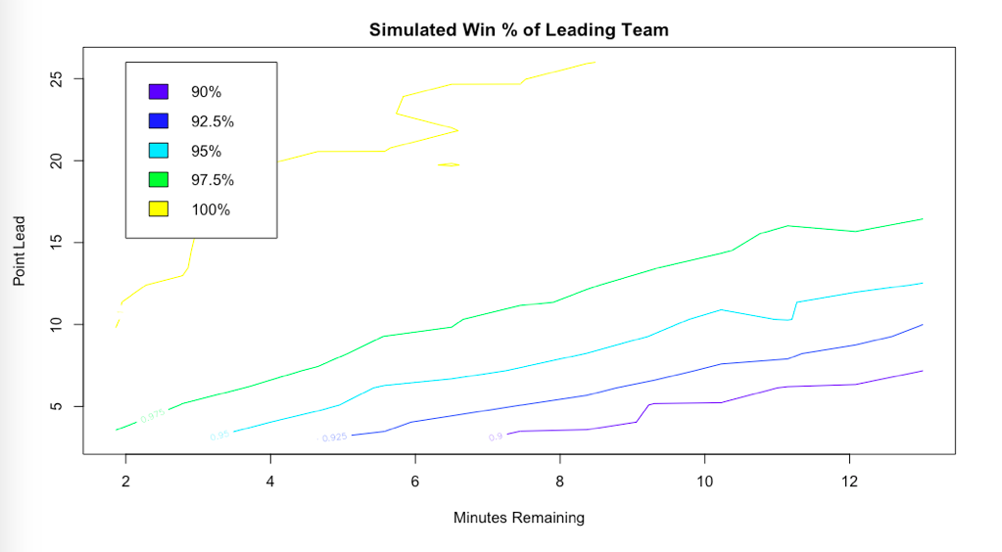
Multiple Regression via R’s contour() function
Notes:
This graph was created with custom function gftopo4(), with m=9000, meaning that number of simulations was run for each cell in the minutes remaining - score difference map, of which there were 13 * 23 based on how this has been framed. This totals to 2,691,000 simulated gameflow tables being represented by this contour plot. What I love about this contour plot is that initially when I approached this problem, I wanted to write a pet algorithm, as I’m sure a lot of smart coaches out there have. But what I ended up seeing was a field of potential pet algorithms, each with its own unique success rate. I found early on that there was no clear winner in comparing linear models to polynomial models, so it seemed natural to take the contour map as a way to logically line up these “pet algorithms” side-by-side and essentially space them out by their level of success (or aggressiveness). With enough simulations, say over a million, these lines are all more or less monotonic.

Slide 16
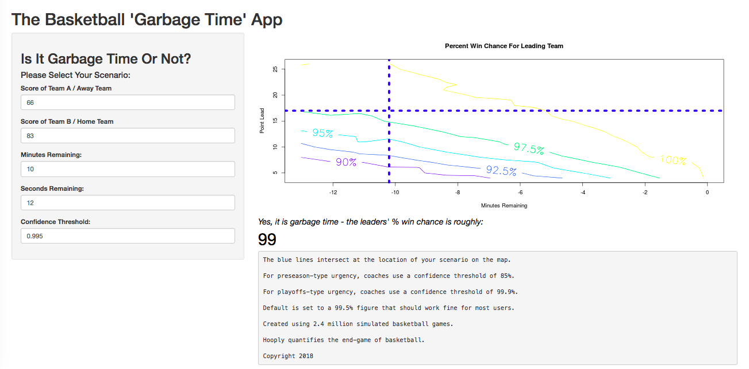
Product: Introducing Hooply
Notes:
A few hundred million simulated baskets later, here we are at a solid map of the probability field of the leading team winning (or one minus the chance of a comeback). This is supposed to be colorful and fun and intuitive for people, and pretty self-explanatory, but I welcome all thoughts and suggestions about the app, I’m still in beta test mode.
Earlier drafts of Hooply had a reversed x-axis, but after switching the values to negative minutes left, it was still possible to run the contour function as normal.

Slide 17
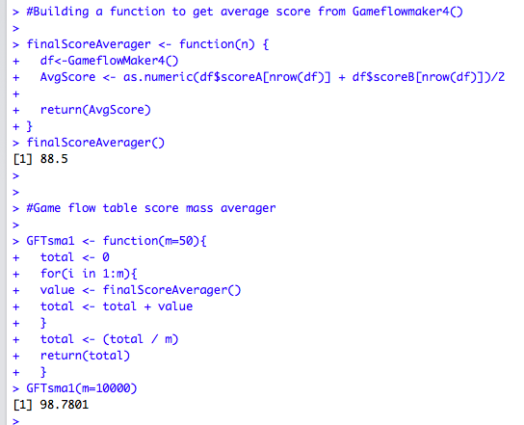
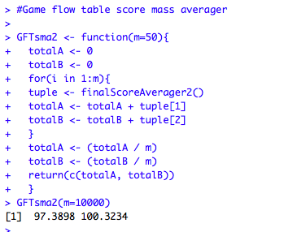
Results: Model Validation via Rate of Scoring
Distance = rate * time ;
Total points = scoring rate * game length
2006/07 NBA season avg. total points per team per game was:
98.7
91 - 119: Range of historical NBA season average game-scores
In 10k runs, home and away avg. score (above)
were within normal range
Notes:
The time to the next made basket is represented in the Gameflowmaker function by a draw from a normal distribution. The advantage we have in this distance equation is that the length of the game we can easily assume is a constant. In end-game analysis it doesn’t matter exactly how many minutes preceded the scenario in question, and no preference was given whether a scenario was in overtime or regular time. Essentially, this is just scoring probabilities per 48 minutes.
Yes, some players are “clutch;” they are represented in these simulations by the high ends of the bell curve. That’s why regular probability distributions were avoided for this analysis. Normal distributions reflect the rarity of exceptional individuals in competitive or game theoretic frameworks.

Slide 18
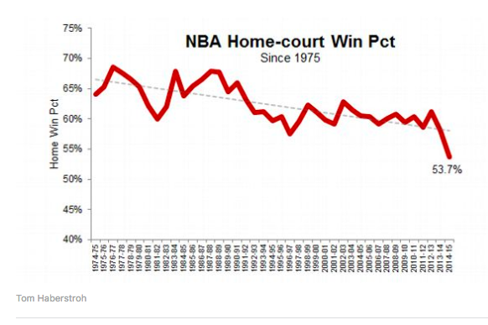
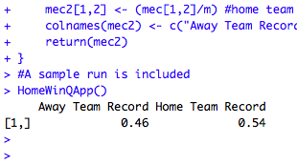
Results: Model Validation via Home vs Away
Customized “HomeWinQApp()” to calculate away and home team records within GameflowMaker4() over 50 games
1975 through 2016
Notes:
Home win percentage has indeed declined over the years, according to the data from Tom Haberstroh of ESPN. This is interesting and gives us a ballpark numeric figure by which to judge or validate the output of the model at hand.

Slide 19
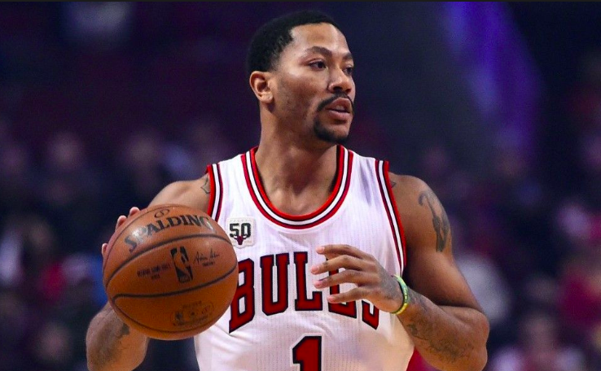
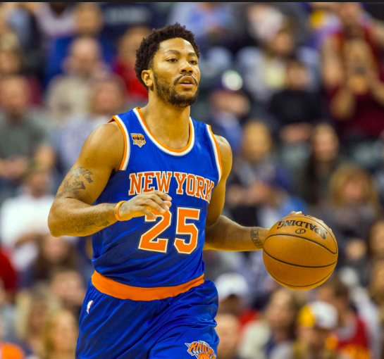
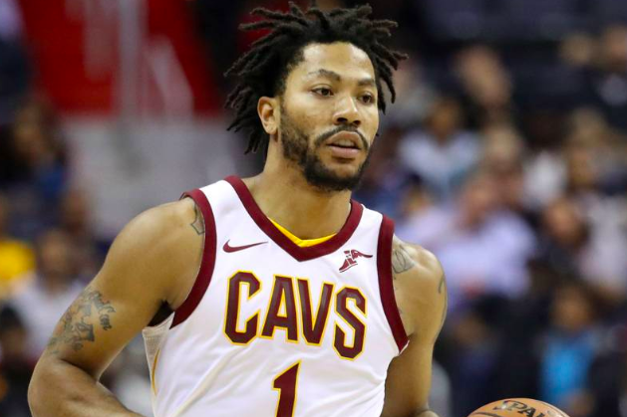

Conclusion
The Bulls have struggled and become a non-competitive team
Since the injury, Rose has been traded 3 times
The former hundred million dollar MVP is now playing on a 1-year $400k contract
Devastating, avoidable injuries can tear apart a star studded team for a franchise worth billions.
Hooply can help coaches overcome mistakes and better-understand when it’s time to substitute out high value players
Notes:
Derrick Rose’s story reminds us that nothing in life is promised, every chance we get is special and the opportunity is there to help is special. Hooply is a unique app and I think it is going to have a big impact on the basketball community worldwide.

Slide 20
Citations:
1. Mertens, J.F. & Zamir, S. Int J Game Theory (1976) 5: 187. https://doi.org/10.1007/BF01761601
2. Westfall, Peter H. “Graphical Presentation of a Basketball Game.” The American Statistician, vol. 44, no. 4, 1990
3. Lewis, Michael. Moneyball. New York : W.W. Norton, 2004.
4. Goel, Sharad. "How Close Is Close?" Messy Matters, May 31, 2012. http://messymatters.com/moneyball/
5. Haberstroh, Tom. (2015, January 28). Home-court advantage? Not so much
6. Badenhausen, Kurt. (2016, December 15) The Average Player Salary
7. Friedell, Nick. (2017, October 24) The Story Of The Chicago Bulls’ Downfall.
Notes:
This is a shortened, prioritized citation list so it could fit on one slide and still be readable for a live audience; the full bibliography is included at the end of the write up I have on Github.

Slide 21
Conclusion
bit.ly/hooply
User Market:
Coaches
Fans
Team Executives
Gamblers and Bookmakers
https://github.com/Carl-4000/Springboard_Intro_To_Data_Science_Thesis_Project_Repository
Notes:
This user category list may be in order of descending market size, by coincidence. Coaches are a natural fit to use this app, but are usually very, very hard-set in their ways, and are often vehemently unreceptive to tools such as this. There will always be leading-edge coaches who try it out and proudly test it, and their success ultimately be the success of this app. Fans will use this app, and their time is valuable too, with tickets being a sunk cost, fans will want to leave a big boring blowout early and beat traffic. Team executives will appreciate being able to “Moneyball” end-game substitutions over the long term, potentially lengthening the viable careers of their star players’, their most valuable possession as a franchise. The largest market really is likely gambling, which has a lot of grey area but is estimated to be in the hundreds of billions in terms of annual market size in the US, as we saw on the earlier slide with the quote from the gaming commission rep.

